Slide 1
Problem Statement
Develop an IoT Solution with Dual Data Flows:
1.Data Streaming: Implement a system to stream data from various sources using the MQTT protocol, ensuring real-time data acquisition and efficient handling of IoT devices.
2.Data Storage: Design a robust database architecture to store the streamed data securely, with considerations for scalability and data integrity.
3.Data Utilization: Create a dynamic web application to consume the stored data, featuring an intuitive dashboard that provides meaningful insights and visualizations for end-users.
Additional Features:
O Data Analytics: Integrate data analytics tools to process and analyze the data for trends and patterns.
O Security Measures: Implement security protocols to protect data during transmission and storage.

Slide 2
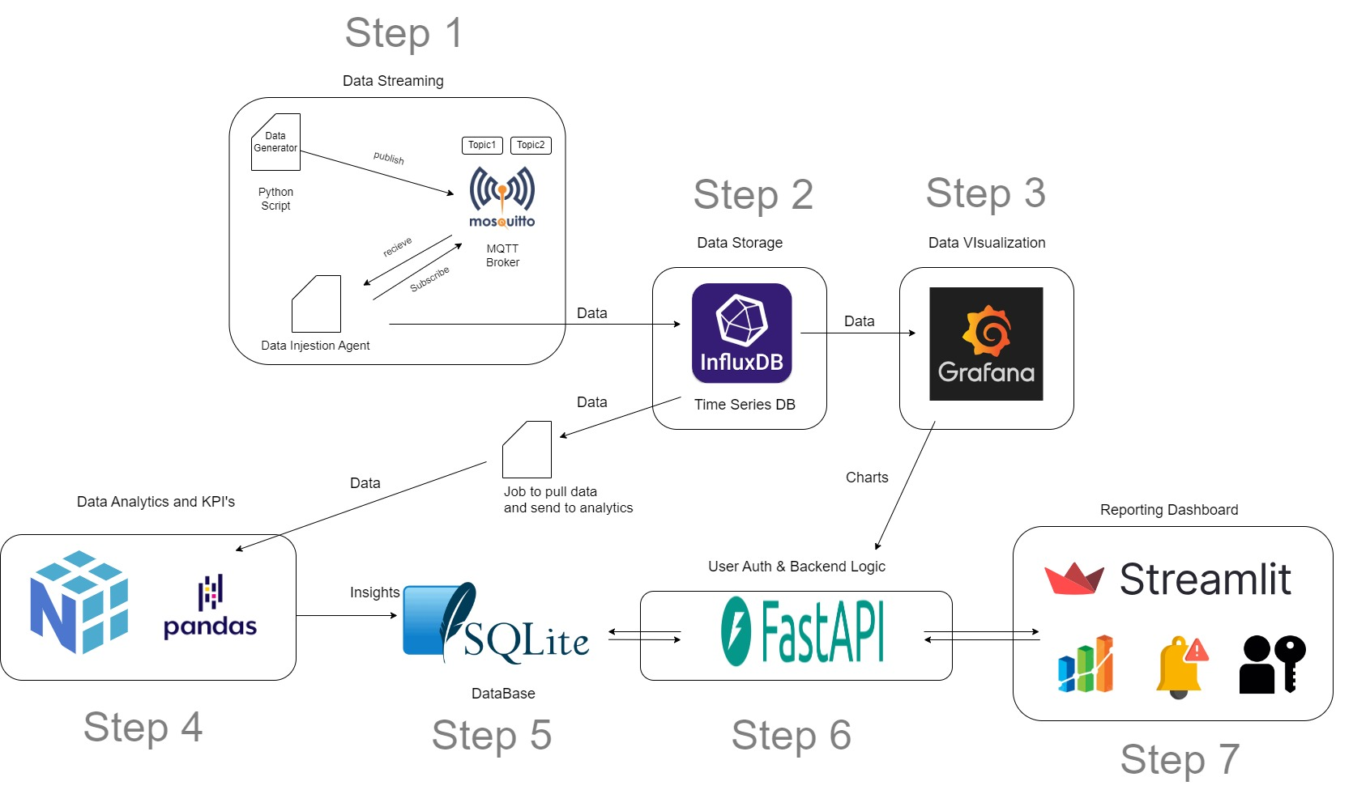
Architecture

Slide 5
Tools and Technologies
Python
Flask for backend
Streamlit for frontend
Numpy , Pandas for data analytics
Influx DB – TimeSeries Database
Mosquitto - MQTT Broker
Grafana - Data Visualization
SQLite - for user metadata, kpi and data insights

Slide 6
Features
Data Generation – Simulated IoT Data publishing to MQTT Broker with trend to data not randomly anything
Data Aquisition and Injestion – DIS subscribes to the MQTT topics -> receives data -> auto forward to InfluxDB
InfluxDB stores time-serie data from DIS, provides high performance and scalability
Data Visualization – Grafana creates real time dashboards which provides valuable insights
Charts –
Line Charts (temp,humidity,power) over time – for all the machine it should be in one chart (machine filter and timeline)
Bar charts (Number of failures per machine)
Pie chart (distribution of machine states (online/offline))
KPI Widgets (uptime percentage,power usage)
User Authentication – prevents unauthorized access to data using JWT token
Real Time Alerts – send notification to users when critical thresholds are breached
Insights from historical data – avg. temp, power consumption, sudden temp spikes, malfunctions, forcasting failures find trends and patterns
Local Deployment – Entire system can be run locally

Slide 7
KPI’s
Machine uptime / downtime
MTTR (mean time to repair)
MTBF (mean time between two failures)
Power Consumption
Failure Rate = Num of failures / Total operation time
Alert response time – time taken by the team to respond to critical alerts
Number of Alerts Triggered
Total online machines and offline machines
Count of data points pushed from publisher and same for subscriber

Slide 8
Table
Risk | Resolution
Influx DB performance issues | Use retention policies,scale influxDB across multiple nodes
Poor Visualization/Incorrect Insights | Validation checks for data sources (template validate)
Notification and alert overload | Only alert for critical conditions, implementing severity levels (trend to the data is generated)
Poor system authentication and authorization | JWT Tokens
Lack of real time processing | Ensure Grafana is configured to display real time alerts

Slide 9
Table
Risk | Resolution
How MQTT is secured | Configure mosquito to use TLS/SSL
Security at influxDB | Enable HTTPS on influxDB server to ensure all data is encrypted in transit

Slide 10
Thank You

